Slide 1
Chapter 4

Slide 2
Objectives

Slide 3
Objectives

Slide 4
The syntax for defining a function

Slide 5
A function that doesn’t accept arguments

Slide 6
A function that has one argument

Slide 7
A function that accepts two arguments and returns a value

Slide 8
A main() function that calls another function

Slide 9
Two ways to call a main() function

Slide 10
The user interface

Slide 11
The code

Slide 12
The code (cont.)

Slide 13
The code (cont.)

Slide 14
A function with a default value

Slide 15
How to call the function and use its default value

Slide 16
How to use default values in your function definitions

Slide 17
How to call the function with named arguments

Slide 18
How to use named arguments in your calling statements

Slide 19
Functions that use local variables

Slide 20
A function that changes a global variable (not recommended)

Slide 21
A local variable that shadows a global variable (not recommended)

Slide 22
A function that uses a global constant (okay)

Slide 23
MODULES

Slide 24
The temperature.py file (temperature module)

Slide 25
The console when you run this module

Slide 26
The temperature module with documentation

Slide 27
How to view the documentation for a module

Slide 28
The syntax for importing a module into a local namespace

Slide 29
The syntax for importing into the global namespace (not recommended)

Slide 30
The user interface

Slide 31
The code

Slide 32
The code

Slide 33
Some of the standard modules presented in this book

Slide 34
Three functions of the random module

Slide 35
A statement that imports the random module

Slide 36
Code that simulates rolling a pair of dice

Slide 37
The user interface

Slide 38
The code

Slide 39
The code (cont.)

Slide 40
A hierarchy chart for the Convert Temperatures program

Slide 41
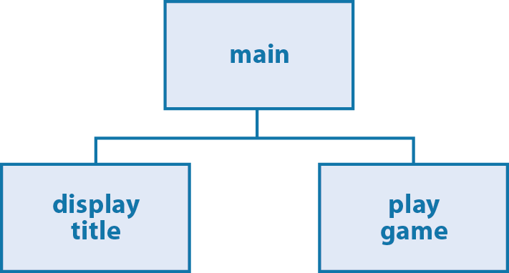
A hierarchy chart for the Guess the Number game

Slide 42
How to build a hierarchy chart

Slide 43
Guidelines for creating hierarchy charts

Slide 44
The rules for a Pig Dice game

Slide 45
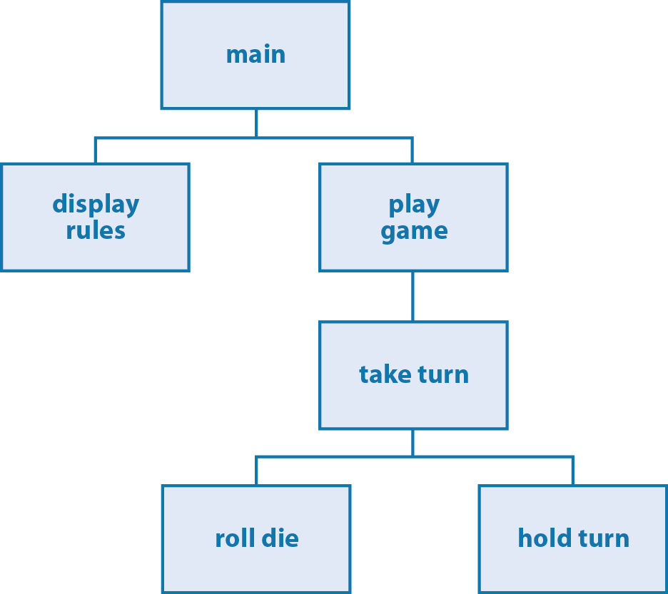
A hierarchy chart for the Pig Dice game

Slide 46
The user interface

Slide 47
The code with global variables

Slide 48
The code with global variables (cont.)

Slide 49
The code with global variables (cont.)

Slide 50
The code with global variables (cont.)

Slide 51
The functions with local variables instead

Slide 52
The functions with local variables instead (cont.)

Slide 53
The functions with local variables instead (cont.)

Slide 54
The functions with local variables instead (cont.)

